Slide 1


21 DAYS OF
MACHINE LEARNING
4/21
---Code Warriors---

Slide 2

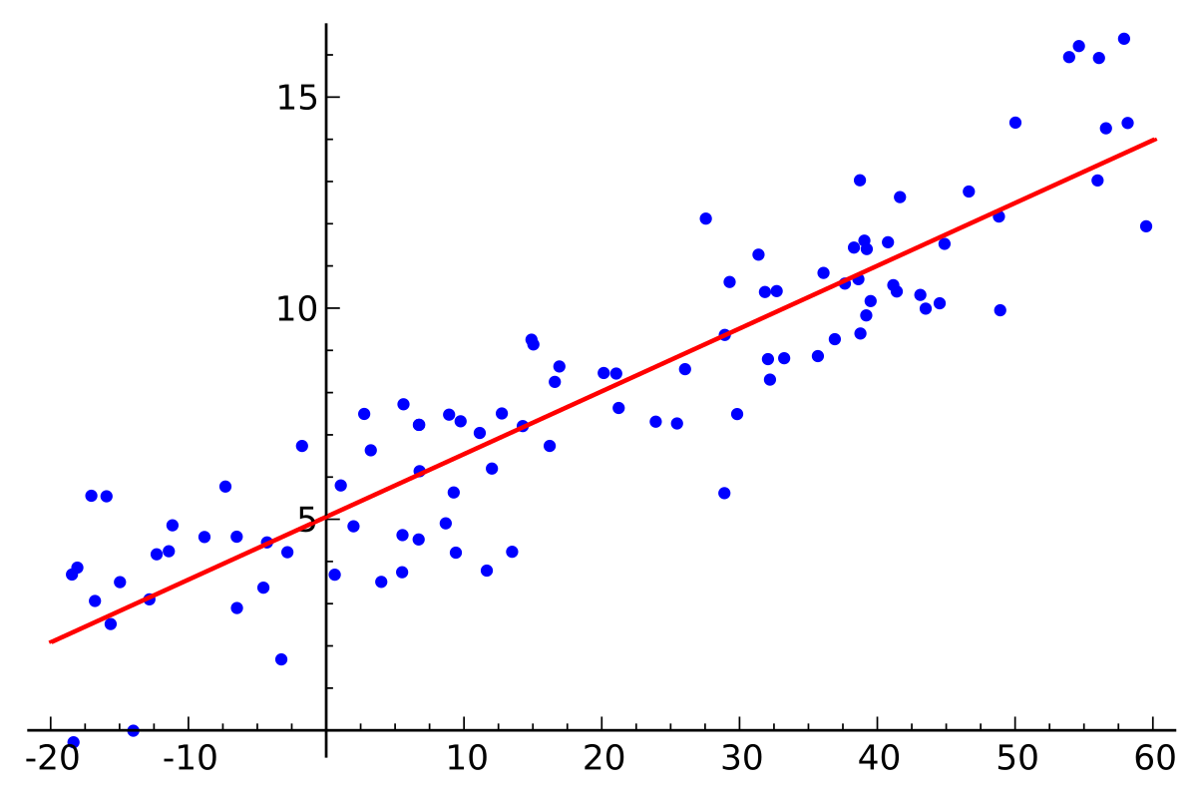
What is Linear Regression
Linear regression is a linear approach to modeling the relationship between dependent variable and one or more independent variables.
---Code Warriors---

Slide 3
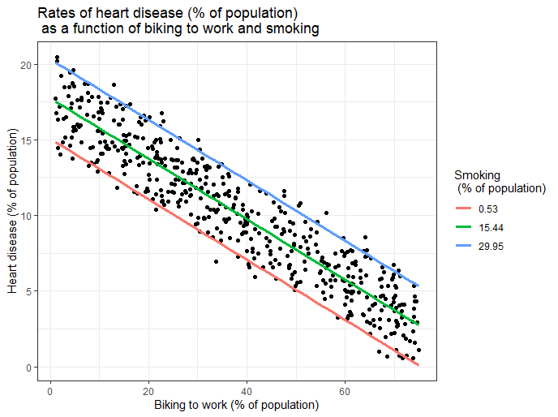
Types of Linear Regression
Simple Linear Regression
Multiple Linear Regression
---Code Warriors---

Slide 4
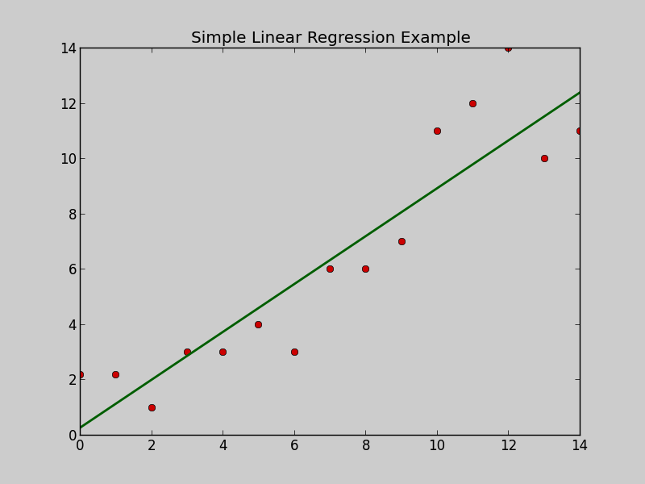
What is Simple Linear Regression
Simple linear regression is a regression model that estimates the relationship between one independent variable and one dependent variable using a straight line. Both variables should be quantitative.
y = mx + c
---Code Warriors---

Slide 5
Linear Regression Model
1
from sklearn.linear_model import LinearRegression
2
regressor = LinearRegression()
3
regressor.fit(X_train, y_train)
4
y_pred = regressor.predict(X_test)
---Code Warriors---

